Slide 1

#LifeKoKaroLift
SGC Coaching
All about Logistic Regression

Slide 2
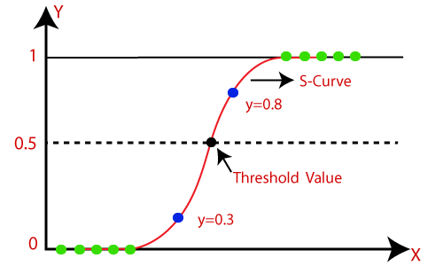
Logistic Regression
Logistic Regression, a statistical model ,a popular and easy-to-understand algorithm that is mainly used to find out the probability of an outcome.
It becomes necessary for every aspiring Data Scientist and Machine Learning Engineer to have a good knowledge of it.
The main objective behind Logistic Regression is to determine the relationship between features and the probability of an outcome.
We can solve classification problem statements which is a supervised machine learning technique using Logistic Regression.
For example,
To predict whether an email is spam (1) or (0)
Whether the tumour is malignant (1) or not (0)

Slide 3

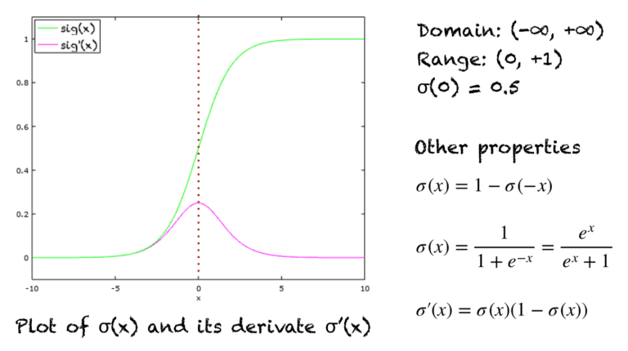
Sigmoid Function
Sigmoid Function
The sigmoid function is a special form of the logistic function and is usually denoted by σ(x) or sig(x). It is given by:
Properties and Identities Of Sigmoid Function
Notes:
A few other properties include:
Domain: (-∞, +∞)
Range: (0, +1)
σ(0) = 0.5
The function is monotonically increasing.
The function is continuous everywhere.
The function is differentiable everywhere in its domain.
Numerically, it is enough to compute this function’s value over a small range of numbers, e.g., [-10, +10]. For values less than -10, the function’s value is almost zero. For values greater than 10, the function’s values are almost one.

Slide 4
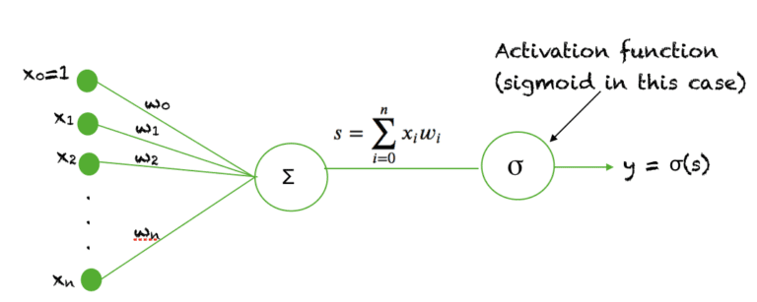
Sigmoid As An Activation Function In Neural Network
The sigmoid function is used as an activation function in neural networks.
An activation function is a non-linear function that takes a weighted sum of inputs and produces an output.
Such a function is termed a 'sigmoid unit' in the context of a neural network.

Slide 5
Reasons for using sigmoid in classification
The main reason why we use sigmoid function is because it exists between (0 to 1).
Therefore, it is especially used for models where we have to predict the probability as an output.
Since probability of anything exists only between the range of 0 and 1, sigmoid is the right choice.
The function is differentiable
Then we set up one threshold value/ cut off value( whatever you call it), from which we predict whether the new data lies in the line of 1’s or 0’s.
That is the basic idea of using Sigmoid function in Logistic regression.

Slide 6
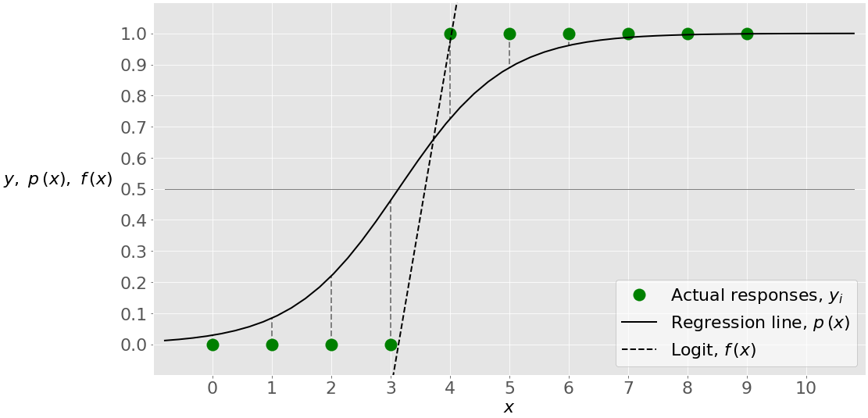
Single-Variate Logistic Regression
In logistic regression, you have a given set of observations (or 𝑥-𝑦) and an independent variable (or feature) -
there is only one such variable, which is (i.e., the input). Logistic regression finds the weights that correspond to the maximum LLF - that is, the limit between the inputs with the predicted outputs of 0 and 1.
In this case, the threshold = 0 corresponds to the value of 𝓥 slightly higher than 3, while the actual output is just below 3.

Slide 7
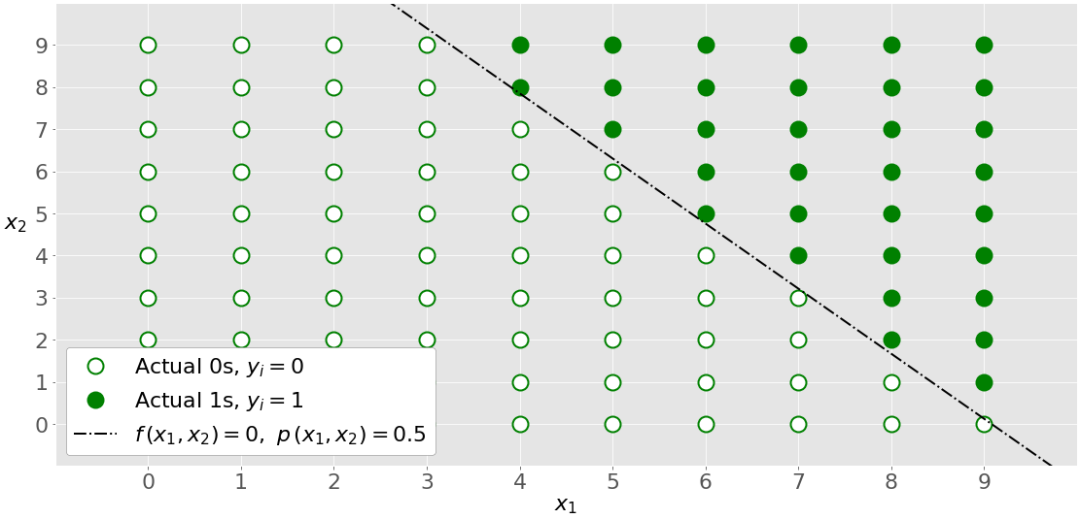
Multi-Variate Logistic Regression
Multi-variate logistic regression has more than one input variable.
Logistic regression determines the weights that maximize the LLF.
The red circles show the observations classified as zeros, while the green circles are those classified as ones.
The dash-dotted black line linearly separates the two classes.

Slide 8
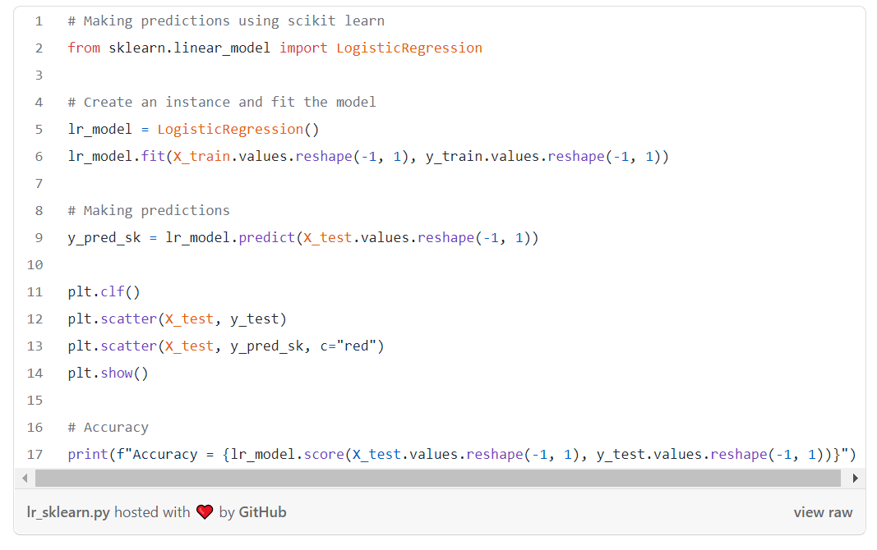

Basic Implementation

Slide 9
Interview preparation
What are the assumptions made in logistic regression?
The logistic regression assumes that there is minimal or no multicollinearity among the independent variables.
There should be a linear relationship between the logit of the outcome and each predictor variables. The logit function is given as logit(p) = log(p/(1-p)), where p is the probability of the outcome.
The logistic regression usually requires a large sample size to predict properly.
The Logistic regression which has two classes assumes that the dependent variable is binary and ordered logistic regression requires the dependent variable to be ordered, for example Too Little, About Right, Too Much.
The Logistic regression assumes the observations to be independent of each other.

Slide 10
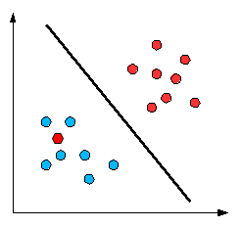
Why is logistic regression called regression and not classification?
Logistic regression is basically a supervised classification algorithm. It can generate the predicted probability as any number ranging from negative to positive infinity. However, probability of an outcome can only lie between 0 and 1. To mitigate the problem of outliers a sigmoid function is used in logistic regression.
What is a decision boundary?
The goal of logistic regression is to figure out some way to split the data to allow for an accurate prediction of a given observation's class. A line or a hyperplane that separates the classes is called a decision boundary. In the case of a generic two-dimensional example, the split might look something like this

Slide 11
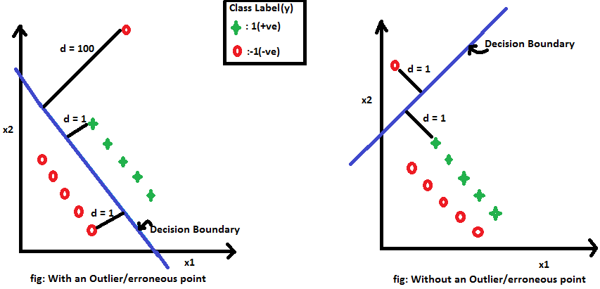
What are outliers and how can the sigmoid function mitigate the problem of outliers in logistic regression?
The sigmoid function plays an important role in mitigating the problem of outliers. Sometimes a dataset can contain extreme values that are outside the range of what is expected and unlike the other data. Let's take a very simple example to see how sum of signed distances can be impacted by an erroneous/outlier points.

Slide 12
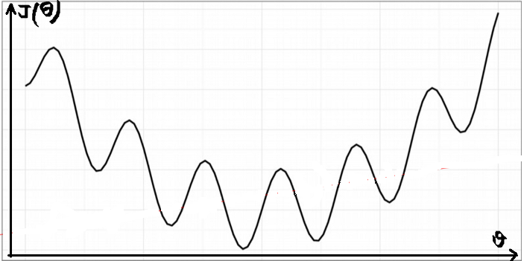
Can the cost function used in linear regression work in logistic regression?
The cost function J(θ) used in linear regression cannot work with logistic regression. Such a cost function produces a nonconvex space that is not ideal for optimization. There will exist many local optima on which our optimization algorithm might prematurely converge before finding the true minimum.

Slide 13
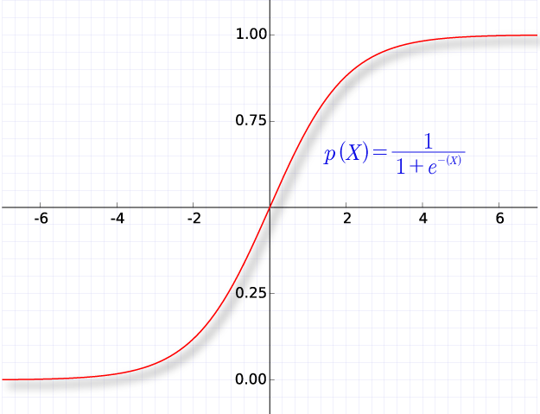
What is squashing in the context of logistic regression?
Squashing function maps the whole real axis into finite interval.
As Zi goes from -∞ to +∞, f(Zi) goes from A to B.
We will be using sigmoid function to squash the value between 0 and 1.
Usually, the predictions in the classification problem are probability values. So we don’t want our model to predict the probability value below 0 or above 1. Sigmoid function helps to achieve that.

